Slide 1




Recurrence Relation

Slide 2

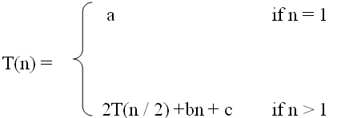
Definition
 A recurrence relation, T(n), variable n.
is a recursive function of integer
Like all recursive functions, it has both recursive case and base case.
Example:
Recurrence relations are useful for expressing the running times (i.e., the number of basic operations executed) of recursive algorithms
E.g . T(n)= 1 if n=1 || n= 2
= T(n-1) + T (n-2 ) if n>=3

Slide 3
Definition
A recurrence is an equation or inequality that describes a function in terms of its smaller input
E.g . T(n)= 1 if n=1
= 2 * T(n/2 ) + n if n>1

Slide 4

Example: Fibonacci Sequence
 The Fibonacci sequence recurrence relation
 f_{n} = f_{n-1} + f_{n-2}, n>=3 and initial conditions
 f ₁ = 1, f₂ = 1.
is defined by the
 Fibonacci Sequence: 1, 1, 2, 3, 5, 8, 13, 21,…….

Slide 5

Solving Recurrence Relation
To solve a recurrence relation T(n) we need to derive a form of T(n) that is not a recurrence relation. Such a form is called a “closed form” of the recurrence relation.
There are four methods to solve recurrence relations that represent the running time of recursive methods:
Iteration method (unrolling and summing)
Recursion Tree method
Substitution method
Master method

Slide 6

The Master Theorem
Given: a divide and conquer algorithm
An algorithm that divides the problem of size
n into a subproblems, each of size n/b
Then, the Master Theorem gives us a method for the algorithm’s running time:

Slide 7

The Master Theorem
 if T(n) = aT(n/b) + f(n) then (where a>=1, b>1)
⎧
⎫
⎪
⎪
⎪
⎪ε > 0
⎪_{Θ(n}log_{b} a ₎
if f (n) = O(n^{logb a −ε} )
) if f (n) = Θ(n^{logb a} )
⎪
⎪
⎪
(n log n
T (n) = ⎨Θ
⎪
log a
b
⎬ c < 1
⎪
⎪
⎪
⎪Θ( f (n))
f (n) = Ω(n^{logb a +ε} )AND
⎪
⎪
⎪⎩
af (n / b) < cf (n) for large n⎪
⎭

Slide 8


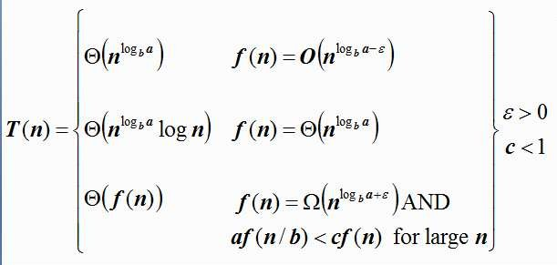
Using The Master Method
 T(n) = 9T(n/3) + n
 a=9, b=3, f(n) = n
n^{logba} = n^{log39} = Θ(n²)
Since f(n) = n, f(n)< n^{logb a}
Case 1 applies:
if f (n) = O(n^{logb a−ε} )
n = O(n^{2-ε} ) take ε = 1 >0 hold
T (n) = Θ(n^{logb a} )
Thus the solution is T(n) = Θ(n²)

Slide 9
Using The Master Method
 T(n) = 5T(n/2) + n²
 a=5, b=2, f(n) = n²
n^{logba} = n^{log25} = Θ(n^{2.32})
Since f(n) = f(n)< n^{logb a}
Case 1 applies:
if f (n) = O(n^{logb a−ε} )
n² = O(n^{2.32 -ε} ) take ε = .32 > 0 hold
T (n) = Θ(n^{logb a} )
Thus the solution is T(n) = Θ(n^{2.32} )

Slide 10
Using The Master Method
 T(n) = 7T(n/2) + n²

Slide 11
Using The Master Method
 T(n) = 7T(n/2) + n²
 a=7, b=2, f(n) = n²
n^{logba} = n^{log27}= Θ(n^{2.81})
Since f(n)< n^{logb a}
Case 1 applies:
if f (n) = O(n^{logb a−ε} )
n² = O(n^{2.81 -ε} ) take ε = .81>0 hold
T (n) = Θ(n^{logb a} )
Thus the solution is T(n) = Θ(n^{2.81} )

Slide 12

Using The Master Method
 T(n) = 4T(n/2) + n²
 a = 4, b = 2, f(n)=n²
_{n}log_{b}a _{= n}2
Since, f(n)=n²
Thus, f(n)= n^{logba}
Case 2 applies:
f (n) = Θ(n^{logb a})
n² = Θ(n ² ) satisfied
Thus the solution is T(n) = Θ(n²log n).

Slide 13
Using The Master Method
 T(n) = T(2n/3) + 1
 a = 1, b = 3/2 , f(n)=1

Slide 14
Using The Master Method
 T(n) = T(2n/3) + 1
 a = 1, b = 3/2 , f(n)=1
_{n}log_{b}a _{= n}log_{3/2} 1
Since, f(n)=n⁰ = 1
Thus, f(n)= n^{logba}
Case 2 applies:
f (n) = Θ(n^{logb a})
1 = Θ(1 ) satisfied
Thus the solution is T(n) = Θ(log n).

Slide 15
Using The Master Method
 T(n) = 16 T(n/4 ) + n ²
T(n) = 16 T(n/2 ) + n ²
T(n) = 2 T(n/4 ) + n ^{½}

Slide 16

Using The Master Method
 Ex. T(n) = 4T(n/2) + n³ a = 4, b = 2, f(n)=n³ n^{logba} = n²; f (n) = n³.
Since, f(n)=n³ Thus, f(n)> n^{logba}




Case 3 applies:
if f (n) = Ω (n^{logb a+ε} )
n ³ = Ω (n ² ^{+ε} )
n ³= Ω(n²⁺¹) if we take ε =1 > 0 hold



Slide 17
Using The Master Method





Case 3 applies: a f(n/b)< c f(n)
4 f(n/2) < c f(n)
4(n/2)³ ≤ cn³ (regulatory condition) for c = 1/2.

T(n) = Θ(n³).

Slide 18
Using The Master Method
 T(n) = 3 T(n/4 )+ n log n a = 3,b =4 , f(n)=n log n n^{logba} = n^{.79} ;
Since, f(n)=n log n Thus, f(n)> n^{logba}




Case 3 applies:
if f (n) = Ω (n^{logb a+ε} )
n log n = Ω (n ^{.79} ^{+ε} )
n log n = Ω(n) if we take ε =.21 > 0 hold



Slide 19
Using The Master Method





Case 3 applies: a f(n/b)< c f(n)
3f(n /4) < c f(n)
3 * n/4 log n/4 ≤ cn log n (regulatory condition) for c = 3/4

T(n) = Θ(n log n ).

Slide 20
Using The Master Method
 T(n) = 5 T(n/2 ) + n ³
T(n) = 7 T(n/3 ) + n ²
T(n) = 7T(n/2 ) + n ²
T(n) = 2 T(n/2 ) + n
T(n) = 2 T(n/2 ) + n ²

Slide 21

Iteration method
Steps:
Expand the recurrence
Express the expansion as a summation by plugging the recurrence back into itself until you see a pattern.
Evaluate the summation

Slide 22


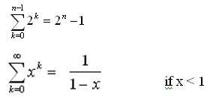


Iteration method
In evaluating the summation one or more of the following summation formulae may be used:
Arithmetic series:
Special Cases of Geometric Series:
Geometric Series:

Slide 23


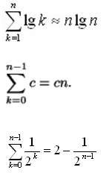
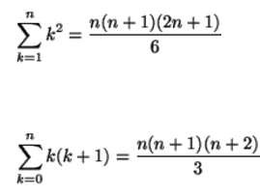
Iteration method
Harmonic Series:
Others:

Slide 24

Recursion-tree method
A recursion tree models the costs (time) of a recursive execution of an algorithm.
The recursion tree method is good for generating guesses for the substitution method.
The recursion-tree method can be unreliable.
The recursion-tree method promotes intuition, however.
In this case, only the largest term in the geometric series matters; all of the other terms are swallowed up by the Θ(·) notation.

Slide 25

Example of recursion tree
Solve T(n) = T(n/4) + T(n/2) + n²:
Root

Slide 26

Example of recursion tree
Solve T(n) = T(n/4) + T(n/2) + n²:
T(n)

Slide 27

Example of recursion tree
Solve T(n) = T(n/4) + T(n/2) + n²:
_{n}2
T(n/4)
T(n/2)

Slide 28

Example of recursion tree
Solve T(n) = T(n/4) + T(n/2) + n²:
_{n}2
(n/4)²
(n/2)²
T(n/16)
T(n/8)
T(n/8)
T(n/4)

Slide 29

Example of recursion tree
Solve T(n) = T(n/4) + T(n/2) + n²:
_{n}2
(n/4)²
(n/2)²
(n/16)²
(n/8)²
(n/8)²
(n/4)²
Θ(1)

Slide 30

Example of recursion tree
Solve T(n) = T(n/4) + T(n/2) + n²:
_{n}2
_{n}2
(n/4)²
(n/2)²
(n/16)²
(n/8)²
(n/8)²
(n/4)²
Θ(1)

Slide 31

Example of recursion tree
Solve T(n) = T(n/4) + T(n/2) + n²:
_{n}2
_{n}2
5 _{n2}
(n/4)²
(n/2)²
16
(n/16)²
(n/8)²
(n/8)²
(n/4)²
Θ(1)

Slide 32

Example of recursion tree
Solve T(n) = T(n/4) + T(n/2) + n²:
_{n}2
_{n}2
5 _{n2}
(n/4)²
(n/2)²
16
25 _{n2}
(n/16)²
(n/8)²
(n/8)²
(n/4)²
256
…
Θ(1)

Slide 33

Example of recursion tree
Solve T(n) = T(n/4) + T(n/2) + n²:
_{n}2
_{n}2
5 _{n2}
(n/4)²
(n/2)²
16
25 _{n2}
(n/16)²
(n/8)²
(n/8)²
(n/4)²
256
…
n (1 + + ( ) + ( ) +☹)
Θ(1)
2
2
3
5
16 16 16
Total =
5
5
= Θ(n²)
geometric series

Slide 34

Solve
1. T(n) = 2 T(n/2 ) + n ² by recursion ree method
2. T(n) = 2 T(n/2 ) + n/ log n by recursion tree method

Slide 35
Substitution Method
The substitution method
A.k.a. the “making a good guess method”
Guess the form of the answer, then use induction to find the constants and show that solution works
Run an example: merge sort
 T(n) = 2T(n/2) + cn
We guess that the answer is O(n lg n)
Prove it by induction
Can similarly show T(n) = Ω(n lg n), thus Θ(n lg n)

Slide 36

Solving Recurrence Relations- Substitution Method
Example: T(n) = 2T(n/2) + n
 Guess T(n) ≤ cn log n for some constant c (that is, T(n)
= O(n log n))
 T(n) = 2T(n/2) + n ≤ 2(c n/2 log n/2 ) + n
= cn log n/2 + n
= cn log n − cn log 2 + n
= cn log n − cn + n
if c ≥ 1 , condition is satisfied. Thus, T(n) = O(n log n)

Slide 37

Some Common Recurrence Relation
Recurrence Relation | Complexity | Problem
T(n) = T(n/2) + c | O(logn) | Binary Search
T(n) = 2T(n-1) + c | O(2^{n}) | Tower of Hanoi
T(n) = T(n-1) + c | O(n) | Linear Search
T(n) = 2T(n/2) + n | O(nlogn) | Merge Sort
T(n) = T(n-1) + n | O(n²) | Selection Sort, Insertion Sort
T(n) = T(n-1)+T(n-2) + c | O(2^{n}) | Fibonacci Series

Slide 38

Summary
Recurrence Relation
Iteration method (unrolling and summing)
Recursion Tree method
Substitution method
Master method

Slide 39
Thanks

